Slide 1

INSTITUTE - UIE
DEPARTMENT- ACADEMIC UNIT-2
Bachelor of Engineering (Computer Science & Engineering)
Subject Name: Introduction to Problem Solving
Code:22CSH-101
Introduction to problem solving
DISCOVER . LEARN . EMPOWER

Slide 2


Introduction to Problem Solving
Course Objectives
The course aims to provide exposure to problem-solving through programming.
The course aims to raise the programming skills of students via logic building capability.
With knowledge of C programming language, students would be able to model real world problems.

Slide 3


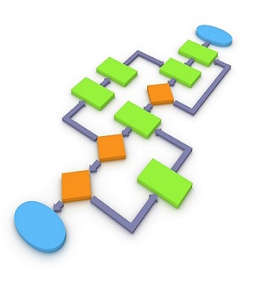
Course Outcomes
CO Number | Course Outcome
CO1 | Remember the concepts related to fundamentals of C language, draw flowcharts and write algorithm/pseudocode.
CO2 | Understand the way of execution and debug programs in C language.
CO3 | Apply various constructs, loops, functions to solve mathematical and scientific problem.
CO4 | Analyze the dynamic behavior of memory by the use of pointers.
CO5 | Design and develop modular programs for real world problems using control structure and selection structure.

Slide 4
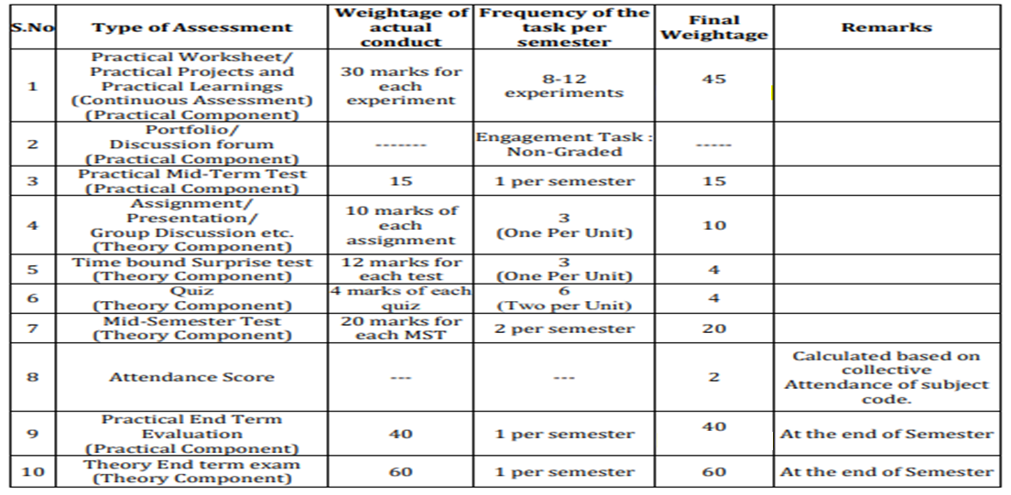
Scheme of Evaluation

Slide 5
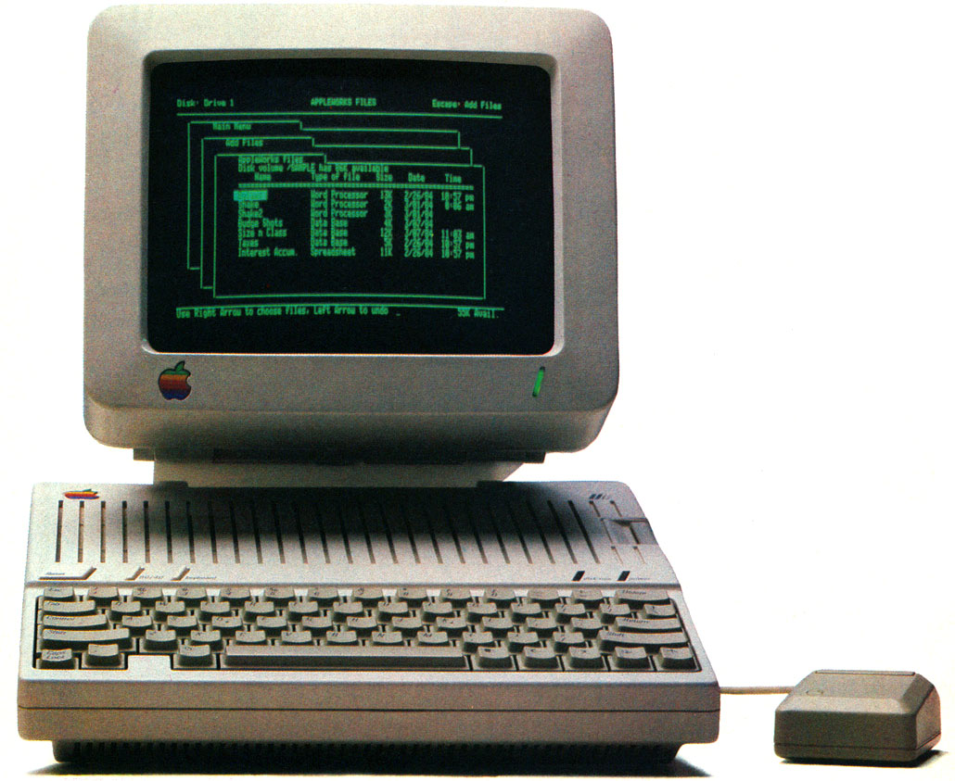
CONTENTS
Space for visual (size 24)
Introduction to problem solving
Problem solving phases
Notes:
Computer in the diagram is 3rd generation computer. The period of third generation was from 1965-1971. The computers of third generation used Integrated Circuits (ICs) in place of transistors. A single IC has many transistors, resistors, and capacitors along with the associated circuitry. The main features of third generation are −
IC used
More reliable in comparison to previous two generations
Smaller size
Generated less heat
Faster
Lesser maintenance
Costly
AC required
Consumed lesser electricity
Supported high-level language

Slide 6
What is a problem?
The definition of a problem is something that has to be solved or an unpleasant or undesirable condition that needs to be corrected.
An example of a problem is an algebra equation.
An example of a problem is when it is raining and you don't have an umbrella.
Everything happening in this world has its problems. This is because no system in this world has 100% efficiency. But this is not a big issue for the people who are prepared to deal with any kind of problem. The field that is heavily affected by the problems in the field of companies and organizations.

Slide 7
Problem Solving
Problem-solving enables us to identify and exploit opportunities in the environment and exert (some level of) control over the future.
Problem solving is the act of defining a problem; determining the cause of the problem; identifying, prioritizing, and selecting alternatives for a solution; and implementing a solution.
Problem solving skills and the problem-solving process are a critical part of daily life both as individuals and organizations.

Slide 8
Characteristics of defining the problem
Differentiate fact from opinion
Specify underlying causes
Consult each faction involved for information
State the problem specifically
Identify what standard or expectation is violated
Determine in which process the problem lies
Avoid trying to solve the problem without data

Slide 9
Phases of solving a problem
Understanding the problem
Making a plan of solution
(i) Finding possible solutions
Carrying out the plan
(i) Choosing the best solution
(ii) Implementing the solution.
Looking back i.e. Verifying

Slide 10
Understanding the Problem
Read the problem very carefully.
Identify the functions that the solution (algorithm) should have.
Identify the required output.
Find a way to produce the required output.
Draw a proper relationship between the input and output.
Take all the necessary number of inputs.
Avoid unnecessary inputs.
Identify the correct number of the required input.

Slide 11
Making a plan of solution
Postpone evaluating alternatives initially
Include all involved individuals in the generating of alternatives
Specify alternatives consistent with organizational goals
Specify short- and long-term alternatives
Brainstorm on others' ideas
Seek alternatives that may solve the problem.

Slide 12
Carrying out the plan
Identifying all the features of an ideal solution, including the constraints it has to meet
Eliminating solutions which do not meet the constraints
Evaluating the remaining solutions against the outcome required
Assessing the risks associated with the 'best' solution
Making the decision to implement this solution
Implementing the solution
This involves three separate stages:
Planning and preparing to implement the solution
Taking the appropriate action and monitoring its effects
Reviewing the ultimate success of the action

Slide 13
Looking back
This final stage requires an evaluation of the outcomes and results of the solution process:
Did the option answer the questions we were working on?
Did this process address the findings that came out of the assumptions?
This process helps keep groups on track, and enables a thorough investigation of the problem and solution search.

Slide 14
Summary
In this lecture we have discussed about problem & problem solving
We have discussed about the phases of problem solving.
We have learnt about problem solving solutions

Slide 15
Frequently Asked question
Q1. What are the phases of problem solving?
Ans:
Understanding the problem
Making a plan of solution
(i) Finding possible solutions
Carrying out the plan
(i) Choosing the best solution
(ii) Implementing the solution.
Looking back i.e. Verifying

Slide 16

REFERENCES
Reference Books
[1] Programming in C by Reema Thareja.
[2] Programming in ANSI C by E. Balaguruswamy, Tata McGraw Hill.
[3] Programming with C (Schaum's Outline Series) by Byron Gottfried Jitender Chhabra, Tata McGraw Hill.
[4] The C Programming Language by Brian W. Kernighan, Dennis Ritchie, Pearson education.
Websites:
https://www.thebalancecareers.com/problem-solving-skills-with-examples-2063764
https://www.mindtools.com/pages/article/newTMC_00.htm
https://asq.org/quality-resources/problem-solving
YouTube Links:
https://www.youtube.com/watch?v=klAE9ML0XLs
https://www.youtube.com/watch?v=8BeXwhljq2g
https://www.youtube.com/watch?v=-c5XAmA5Oc4

Slide 17
THANK YOU

